Slide 1

Modelling Anthropogenic Climate Change
By Thomas Davies
Supervised by: Craig P. Testrow & Richard J. Wilman
Department of Physics, Durham University

Slide 2
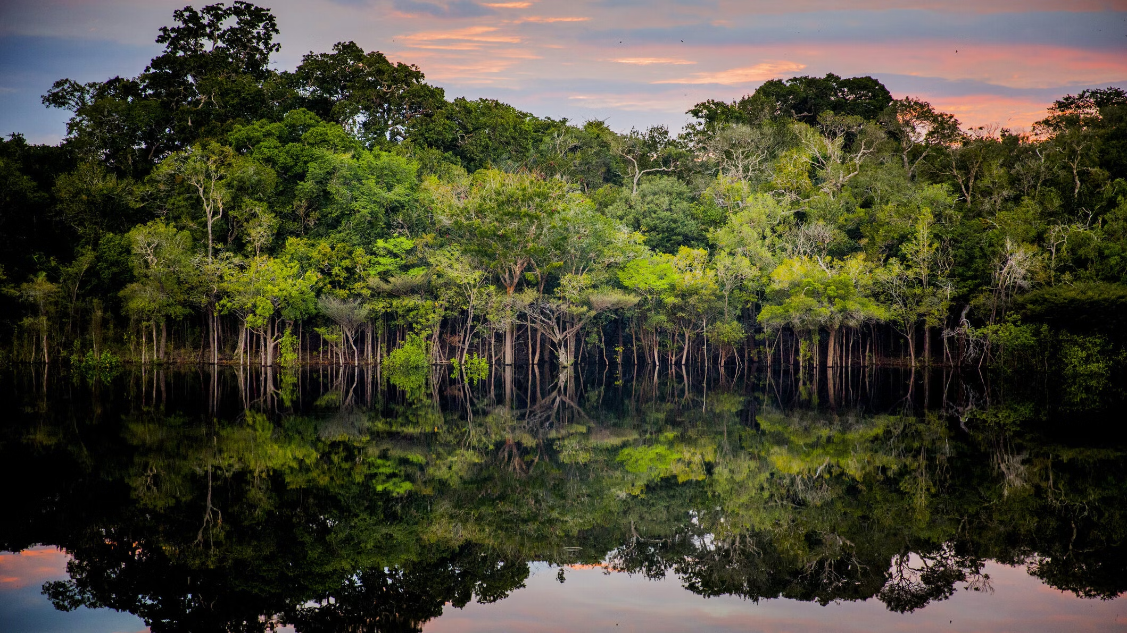
Seminar Outline
Project Aim
Q & A
The Climate Crisis
Temperature Forecasts
The Climate Model
(iStock / Anna Carolina Negri)

Slide 3
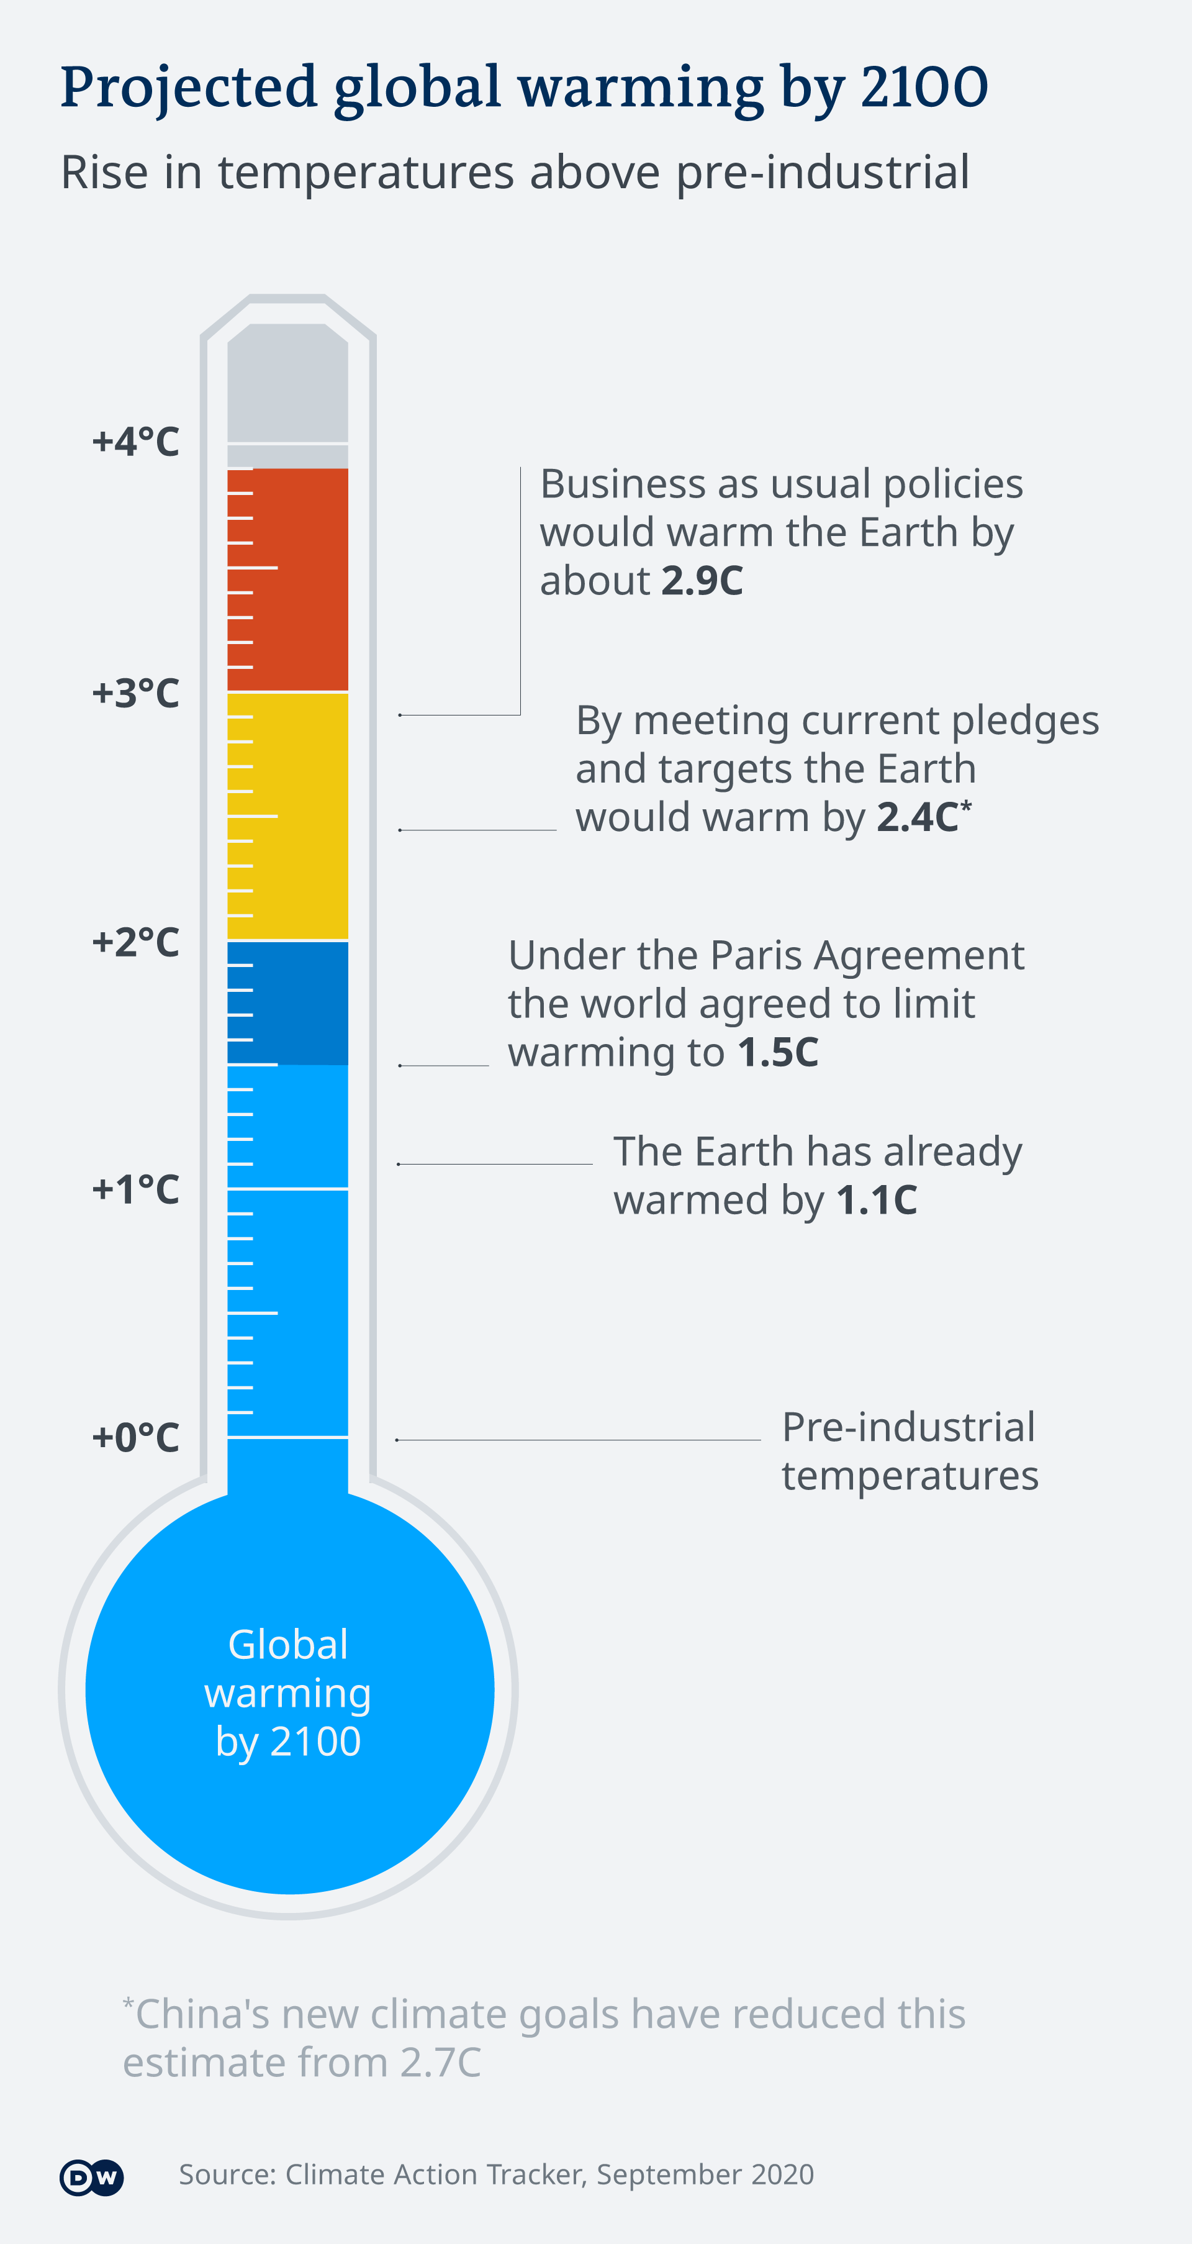
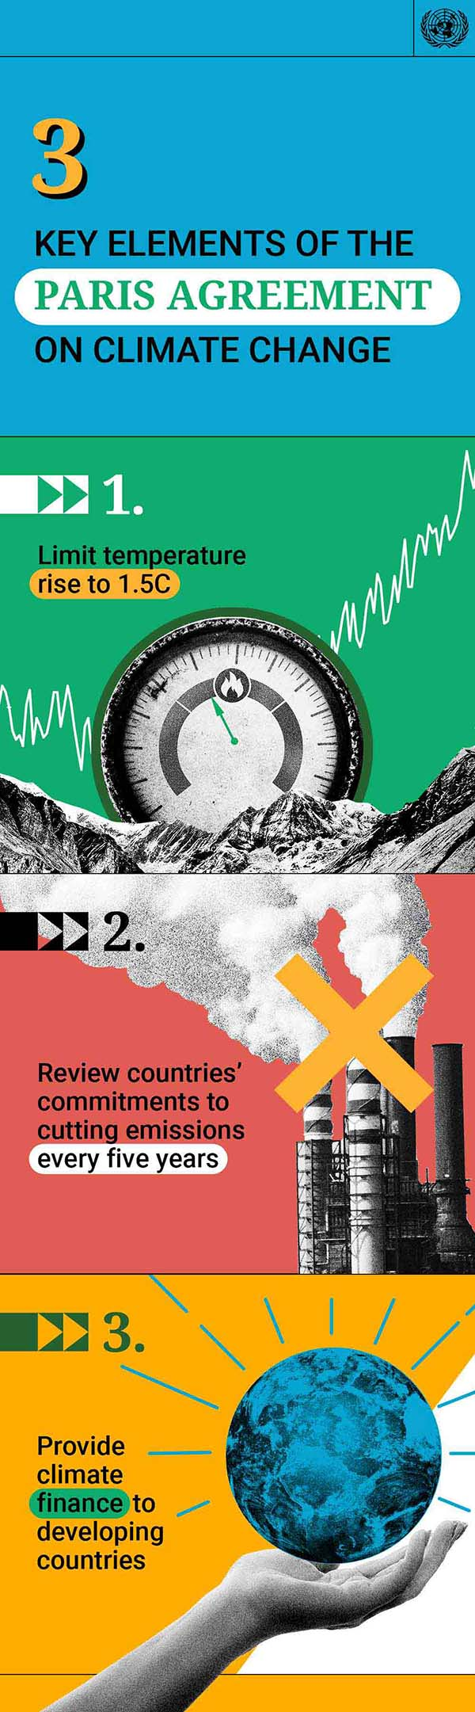
Project Aim
Will the Paris Agreement solve climate change?
“National climate action plans remain insufficient to limit global temperature rise to 1.5 degrees Celsius” – IPCC 2023 Report
Project Aim
To understand the implications of various emission scenarios, aiding in the selection of a new Paris Agreement.
(Src: un.org)

Slide 4
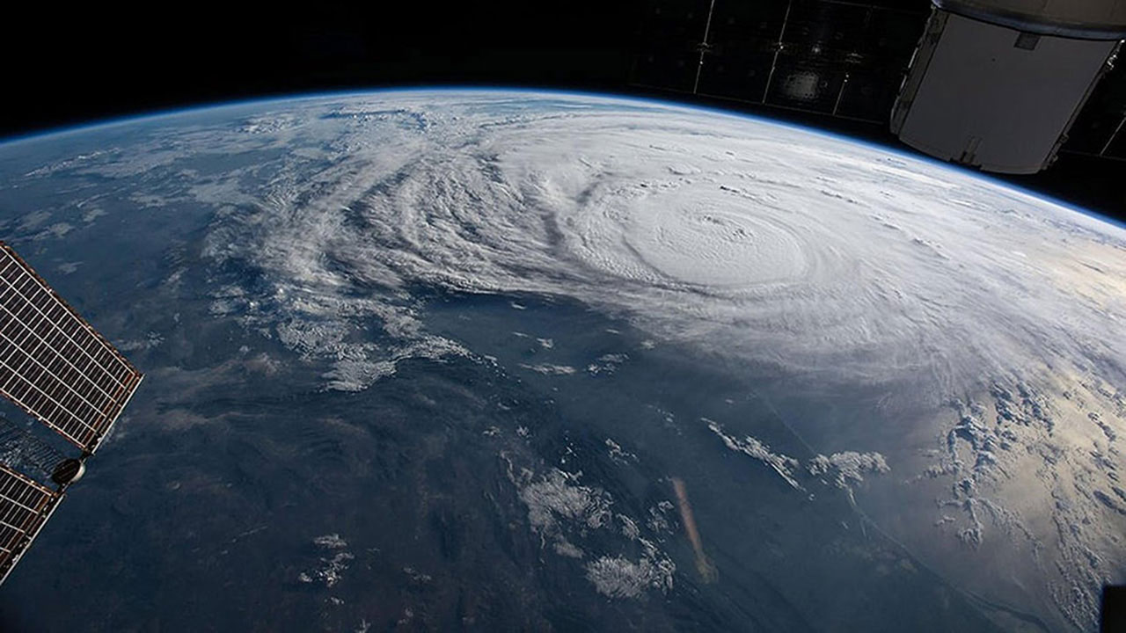
The Climate Crisis
(issnationallab.org)

Slide 5
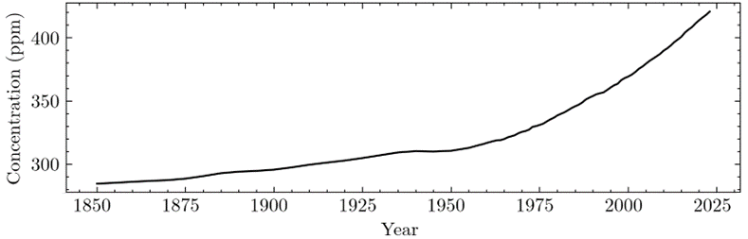
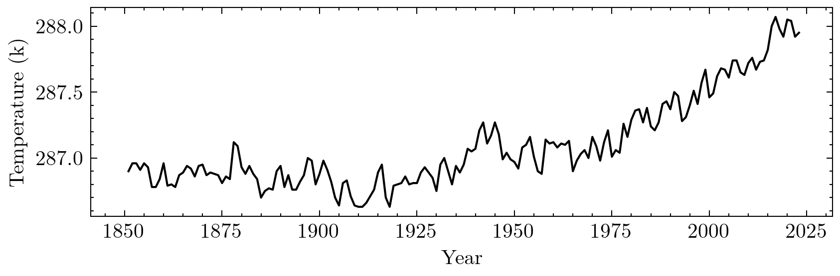
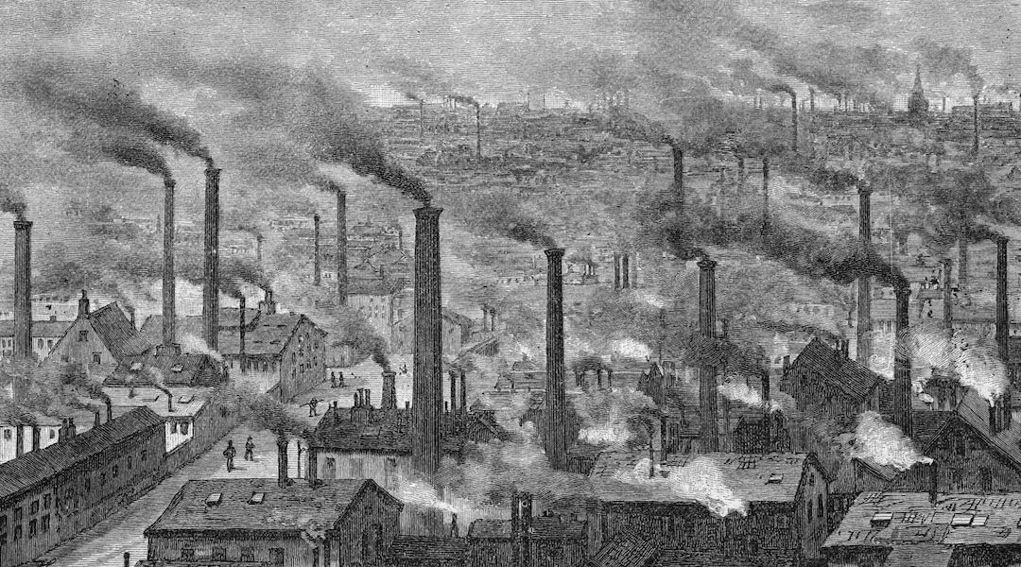
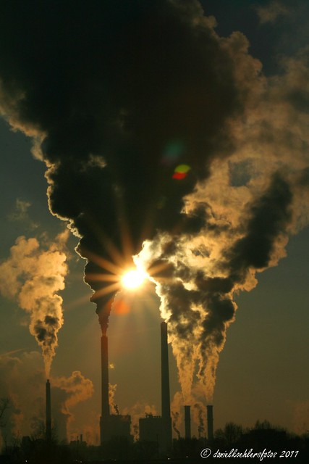
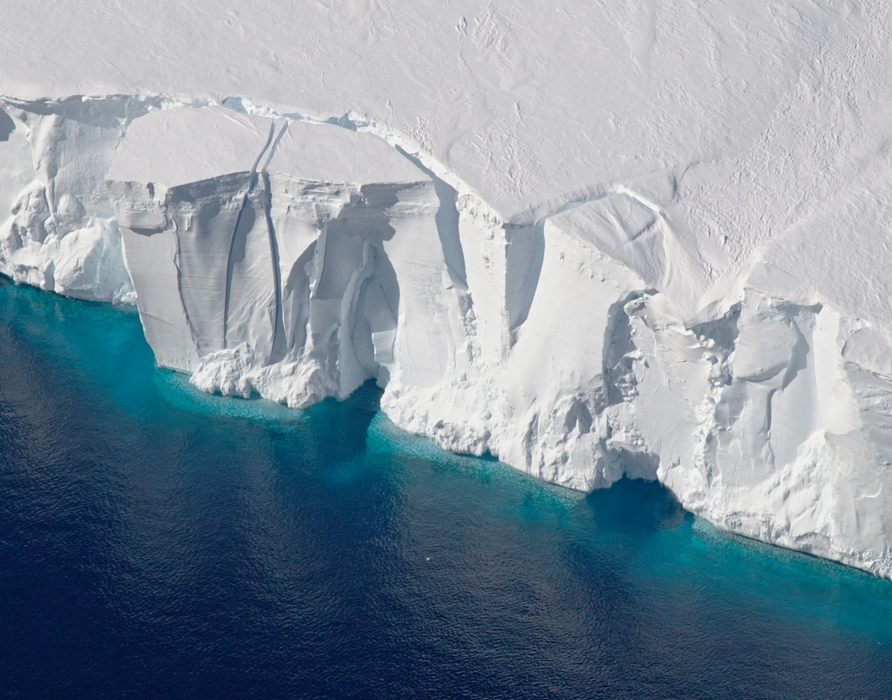
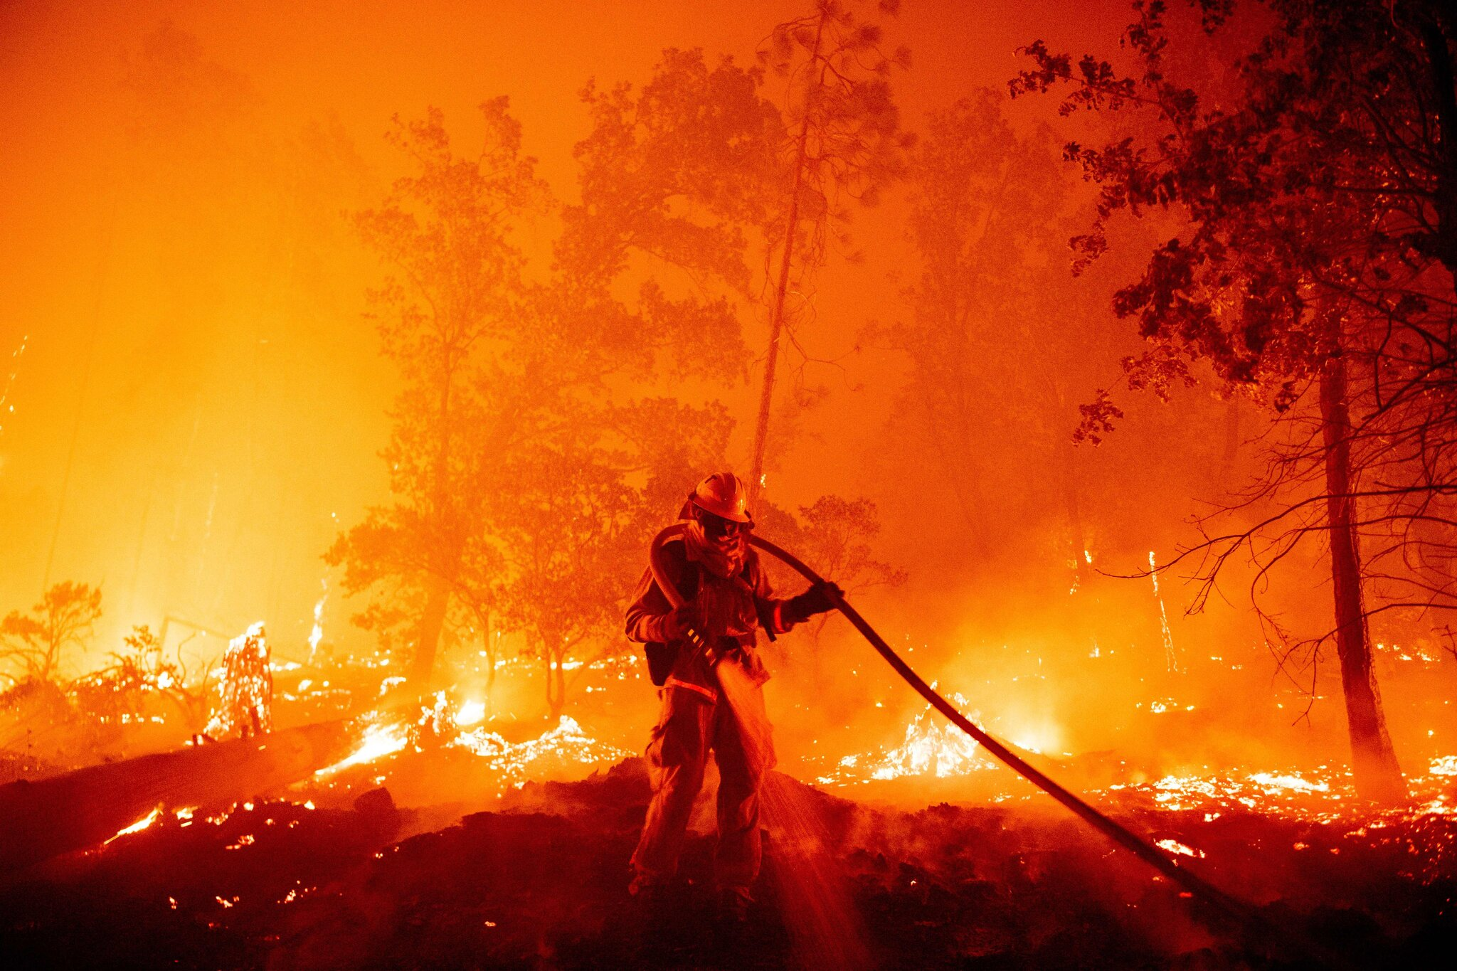
Atmospheric CO2 levels
Why are CO2 levels increasing?
What is the global temperature trend?
(merchantsandmechanics.com)
(flickr.com / Daniel Kohler)
(NASA)
(Josh Edelson/AFP/Getty Images)

Slide 6
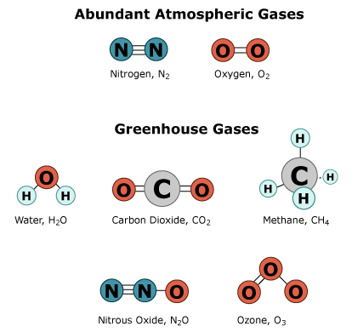
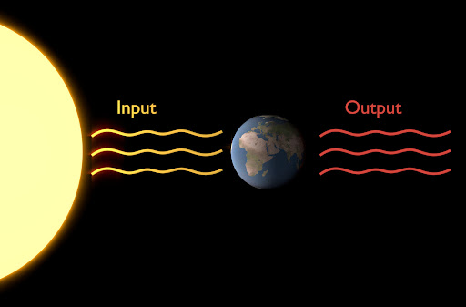
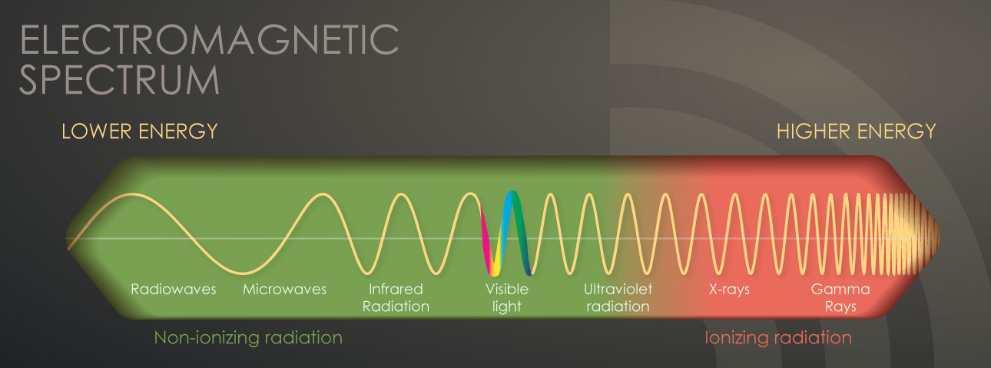
The Greenhouse effect
What is a greenhouse gas?
How do they effect global temperature?
(wwwcdn.imo.org)
(integrate.mutz.science, cdc.gov)

Slide 7
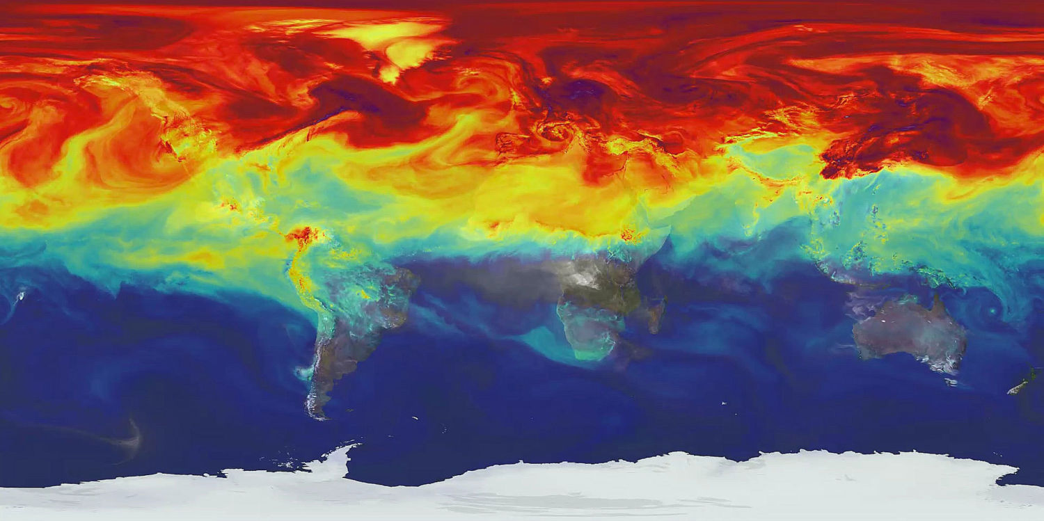
The Climate Model
(NASA)

Slide 8
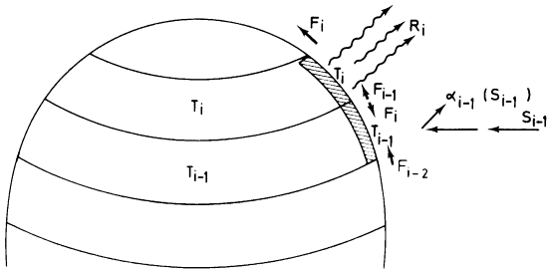
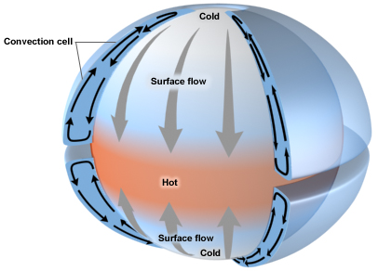
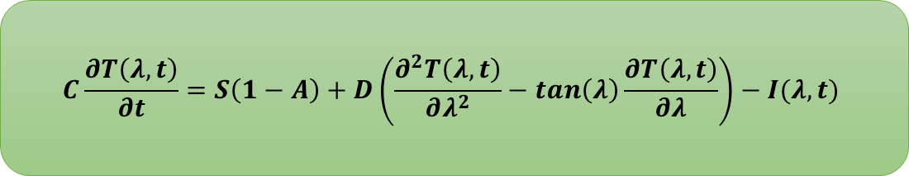
Climate Model
What is a 1-D EBM?
$$C\frac{∂T\left(λ, t\right)}{∂t}=S\left(1−A\right)+D\left(\frac{∂^{2}T\left(λ, t\right)}{∂λ^{2}}−\tan\left(λ\right)\frac{∂T\left(λ, t\right)}{∂λ}\right)−I(λ,t)$$
(psu.edu)
(springer.com)

Slide 9
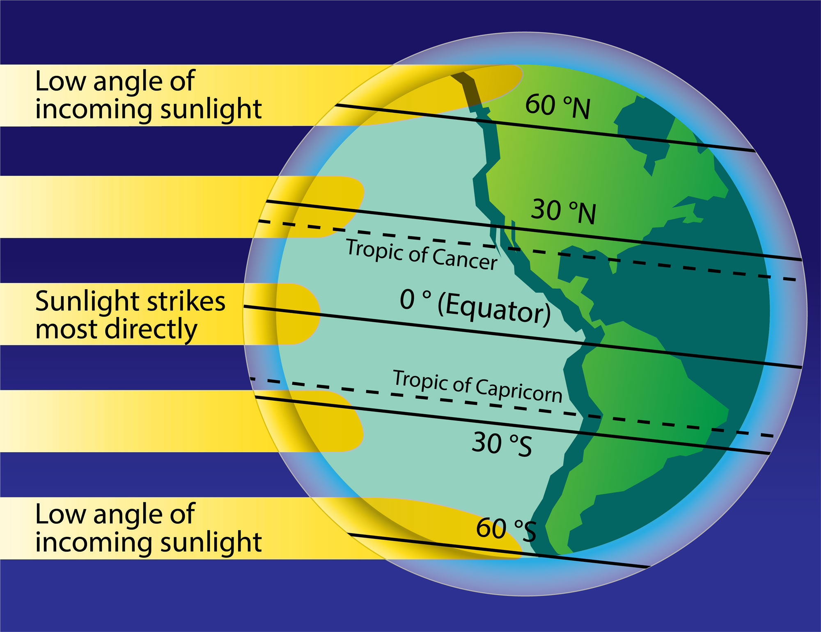
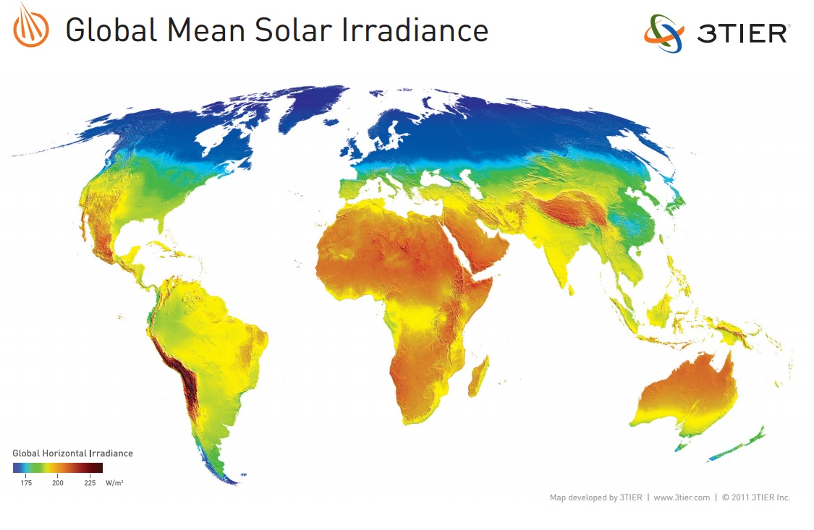
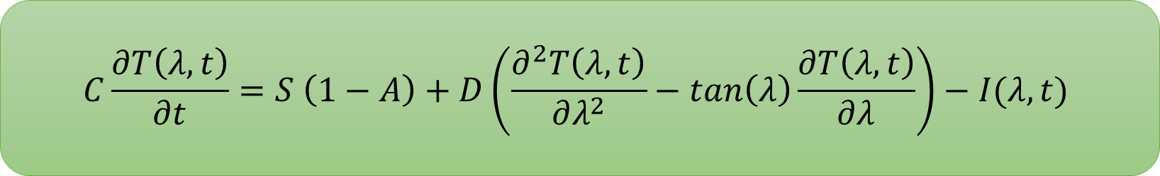
Solar Flux
$$C\frac{∂T\left(λ, t\right)}{∂t}=S \left(1−A\right)+D\left(\frac{∂^{2}T\left(λ, t\right)}{∂λ^{2}}−\tan\left(λ\right)\frac{∂T\left(λ, t\right)}{∂λ}\right)−I(λ,t)$$
(berkeley.edu)
(3tier.com)

Slide 10
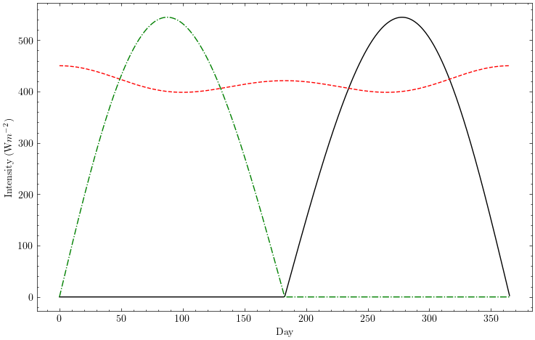

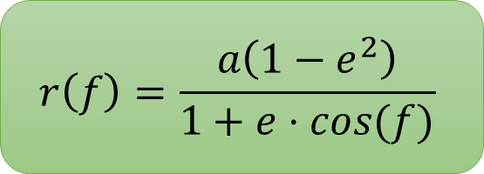

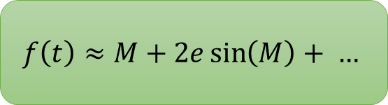
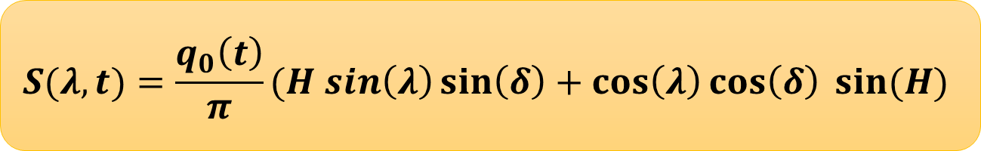
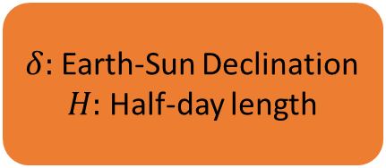
Solar Flux
How do we calculate $S$?
$$f\left(t\right)≈M+2e\sin\left(M\right)+ …$$
$$r\left(f\right)=\frac{a\left(1−e^{2}\right)}{1+e⋅cos(f)}$$
$$q_{0}\left(t\right)=\frac{L_{sol}}{4π r^{2}}$$
$$S(λ,t)=\frac{q_{0}\left(t\right)}{π}(H sin\left(λ\right)\sin\left(δ\right)+\cos\left(λ\right)\cos\left(δ\right) sin⁡(H)$$
$δ:$ Earth-Sun Declination
$H:$ Half-day length

Slide 11
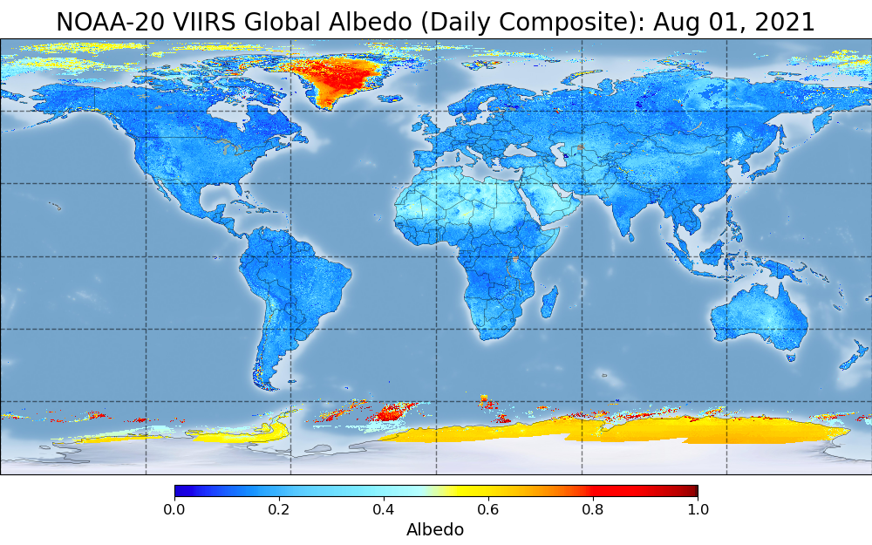
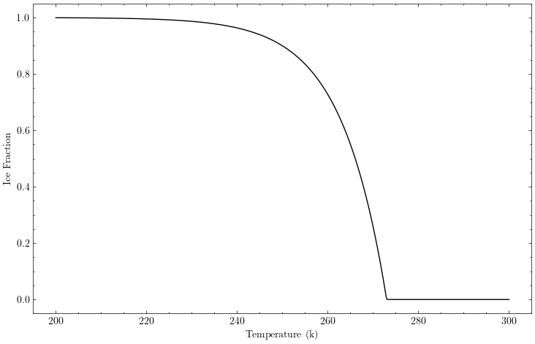
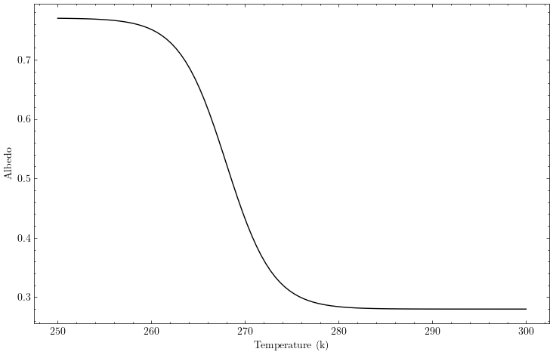
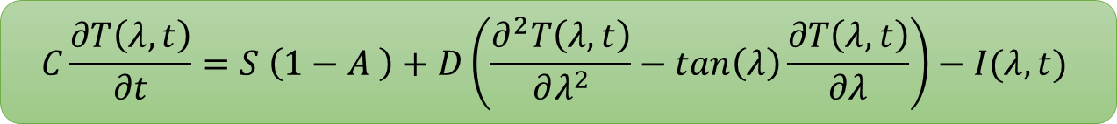
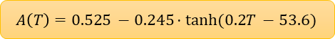
Surface Albedo
$$C\frac{∂T\left(λ, t\right)}{∂t}=S \left(1−A \right)+D\left(\frac{∂^{2}T\left(λ, t\right)}{∂λ^{2}}−\tan\left(λ\right)\frac{∂T\left(λ, t\right)}{∂λ}\right)−I(λ,t)$$
$$A\left(T\right)=0.525 −0.245⋅tanh⁡(0.2T −53.6)$$
(noaa.gov)

Slide 12
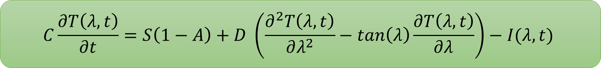
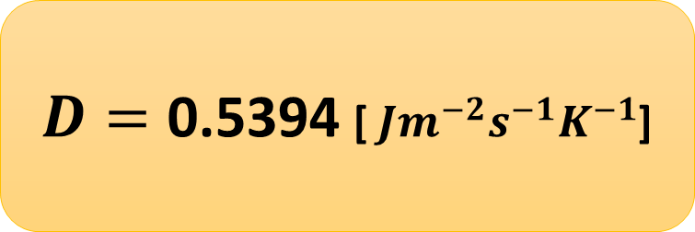
Horizontal Transport
$$C\frac{∂T\left(λ, t\right)}{∂t}=S\left(1−A\right)+D \left(\frac{∂^{2}T\left(λ, t\right)}{∂λ^{2}}−\tan\left(λ\right)\frac{∂T\left(λ, t\right)}{∂λ}\right)−I(λ,t)$$
$D=\text{0.5394}$ [ $Jm^{−2}s^{−1}K^{−1}$]
(springer.com)

Slide 13
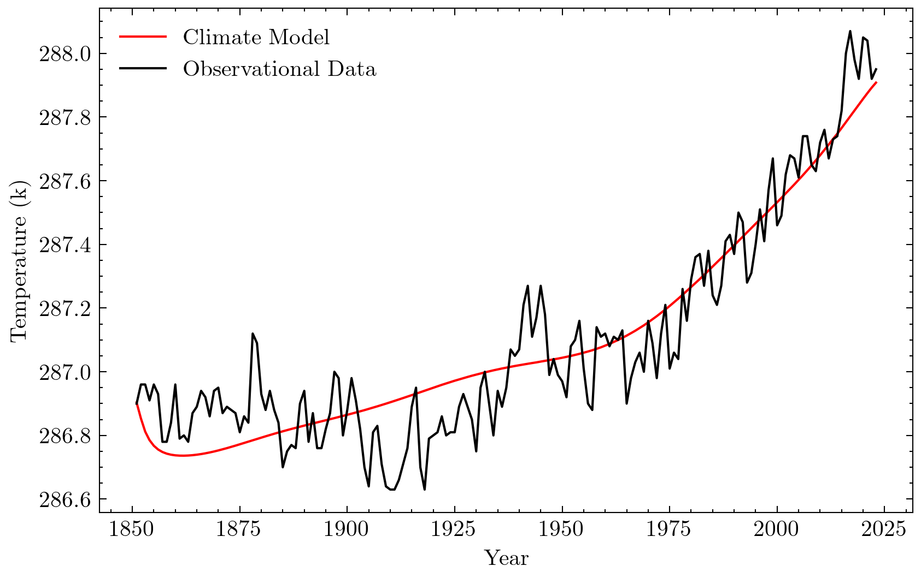
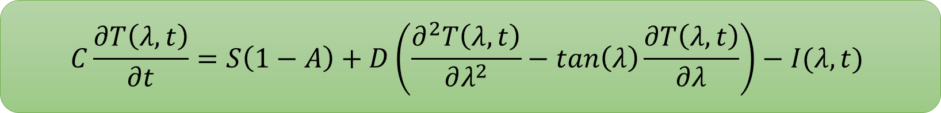
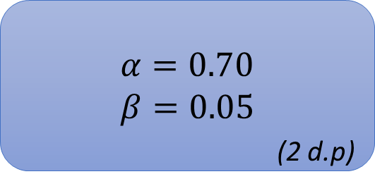
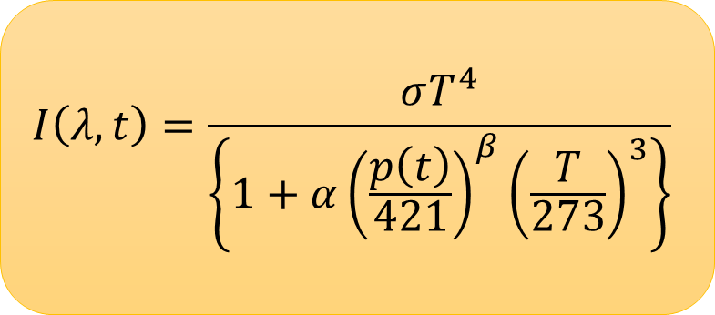
Infrared Cooling
$$C\frac{∂T\left(λ, t\right)}{∂t}=S\left(1−A\right)+D\left(\frac{∂^{2}T\left(λ, t\right)}{∂λ^{2}}−\tan\left(λ\right)\frac{∂T\left(λ, t\right)}{∂λ}\right)−I(λ,t)$$
$$I\left(λ, t\right)=\frac{σT^{4}}{\left\{1+α{\left(\frac{p\left(t\right)}{421}\right)}^{β}{\left(\frac{T}{273}\right)}^{3}\right\}}$$
$α=0.70$
$β=0.05$
(2 d.p)

Slide 14
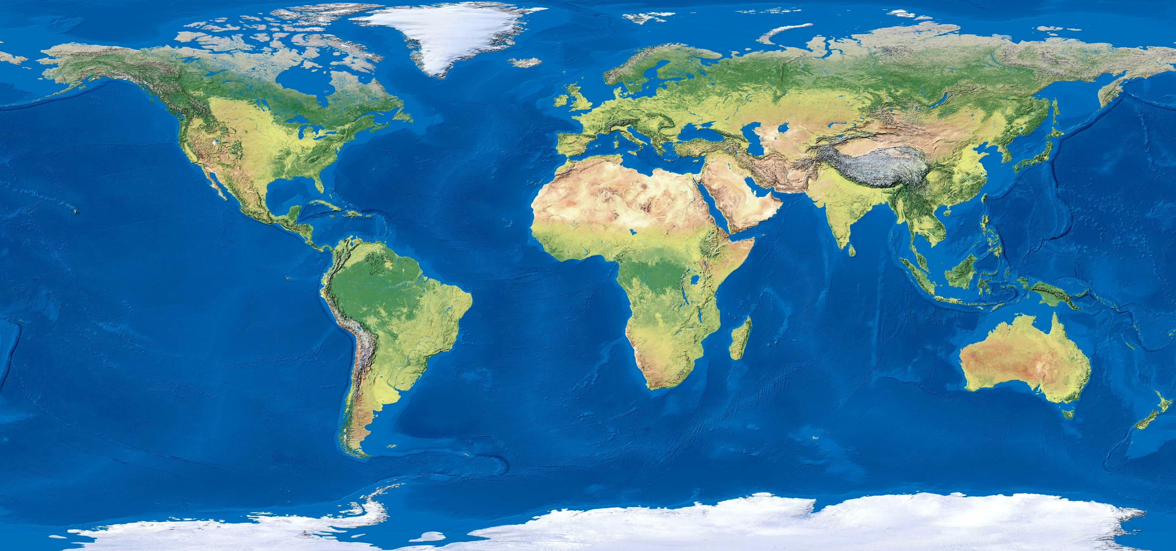
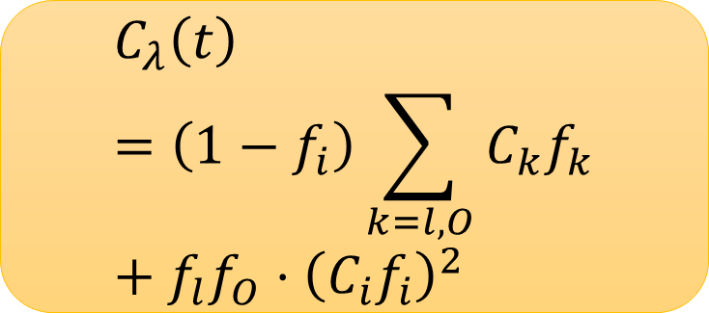
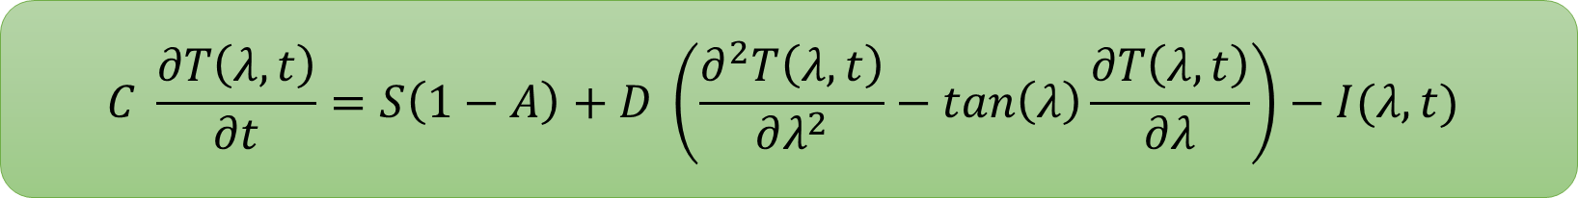
Heat Capacity
$$C \frac{∂T\left(λ, t\right)}{∂t}=S\left(1−A\right)+D \left(\frac{∂^{2}T\left(λ, t\right)}{∂λ^{2}}−\tan\left(λ\right)\frac{∂T\left(λ, t\right)}{∂λ}\right)−I(λ,t)$$
$$C_{λ}\left(t\right)=\left(1−f_{i}\right)\sum_{k=l,O}{C_{k}f_{k}}+{f_{l}f_{O}⋅\left(C_{i}f_{i}\right)}^{2}$$
(surfertoday.com)

Slide 15
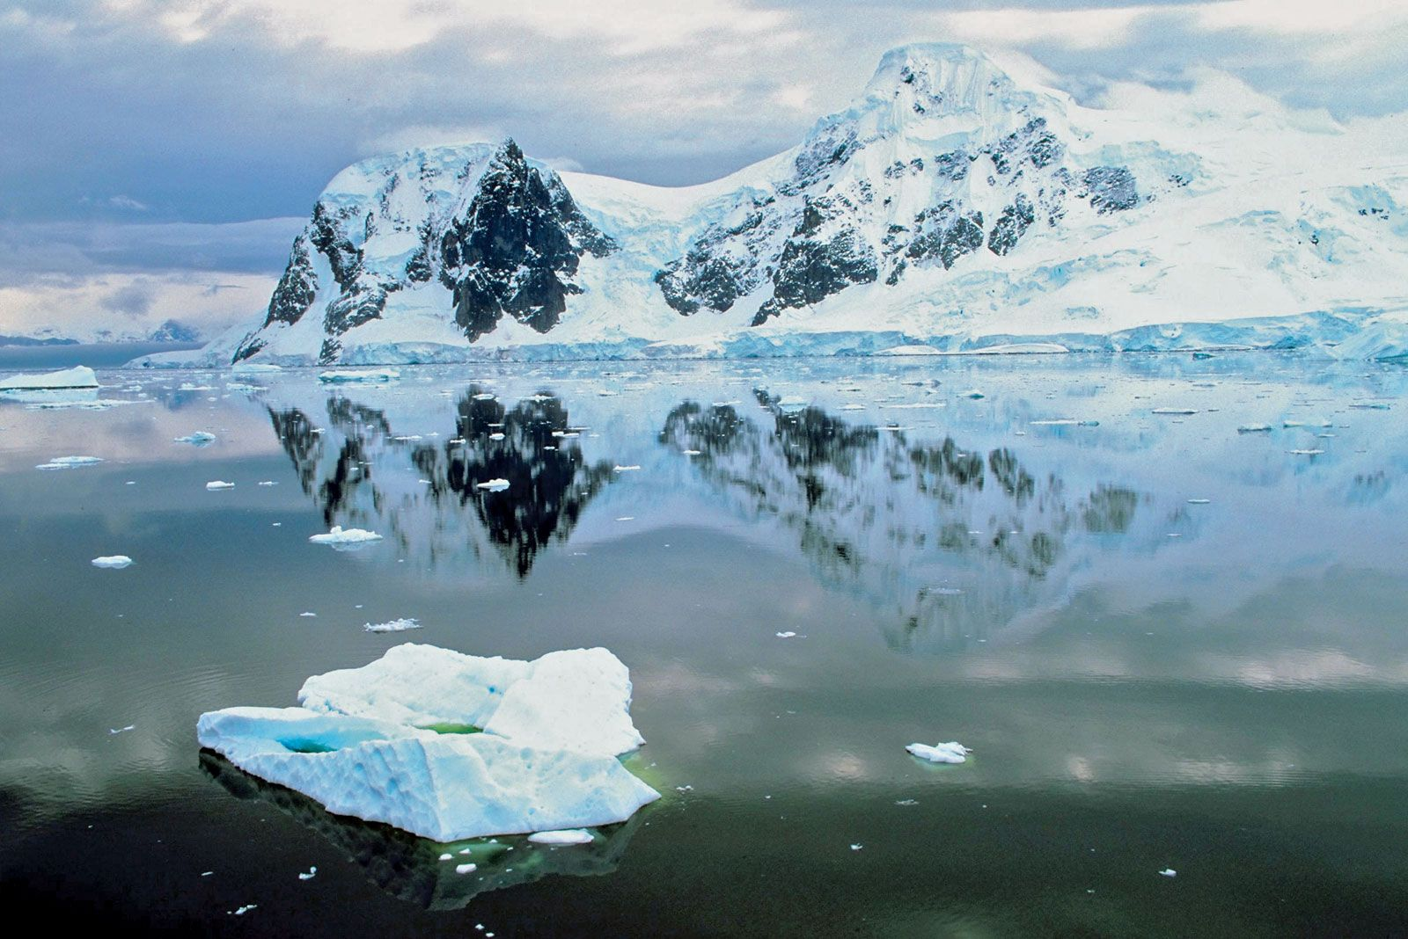
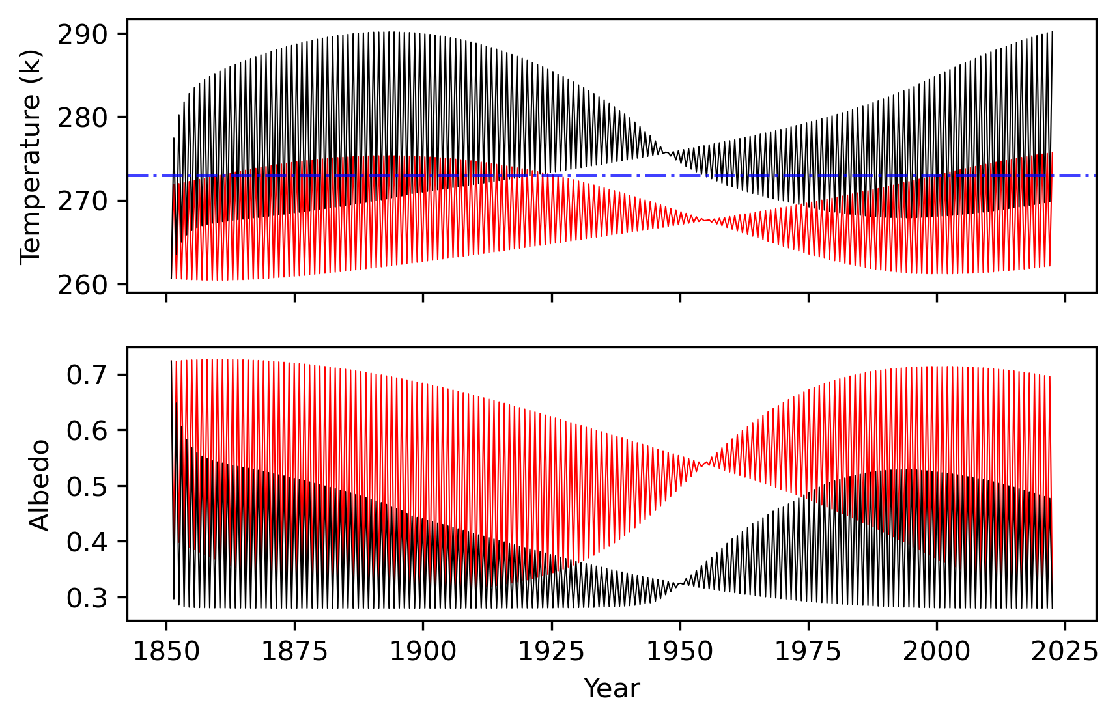
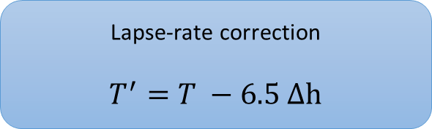
Antarctica
(surfertoday.com)
Why does Antarctica need special treatment?
Antarctica sits 2500m above sea-level
Significant surface albedo deviation
Lapse-rate correction
$$T^{′}=T −6.5 Δh$$
More accurate albedo

Slide 16
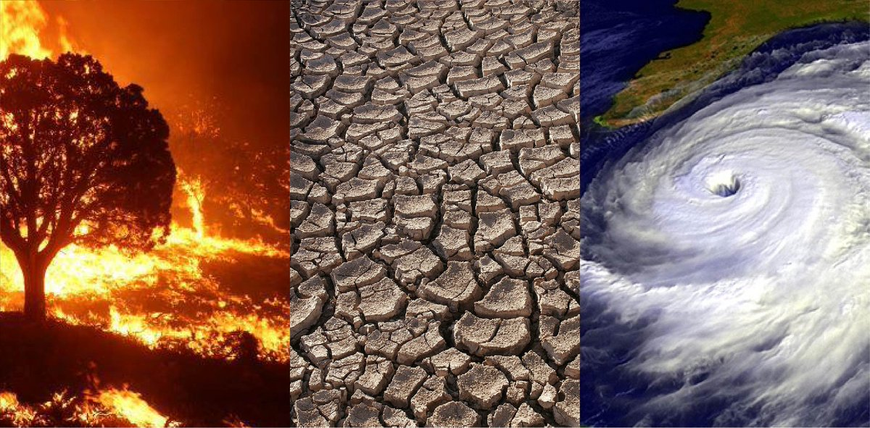
Temperature Forecasts
(NASA)

Slide 17
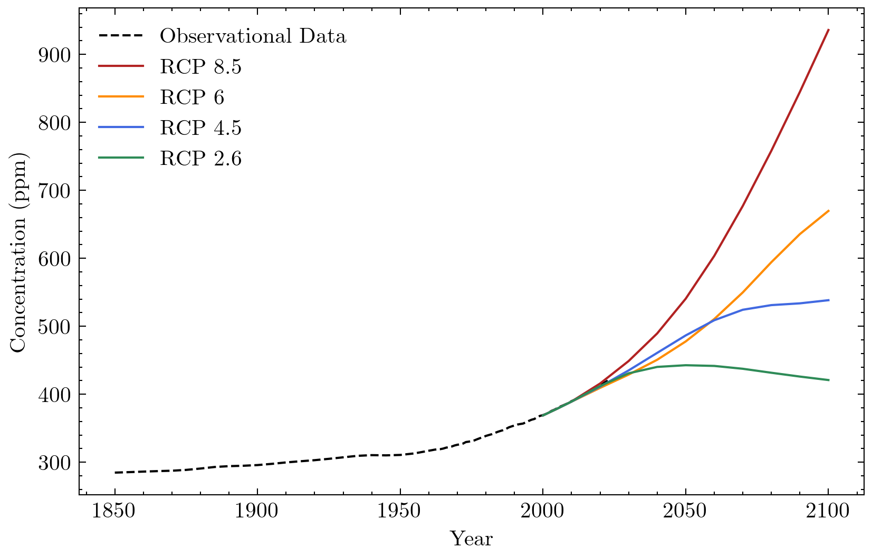
Representative Concentration Pathways (RCPs)
How do we produce global temperature forecasts?

Slide 18
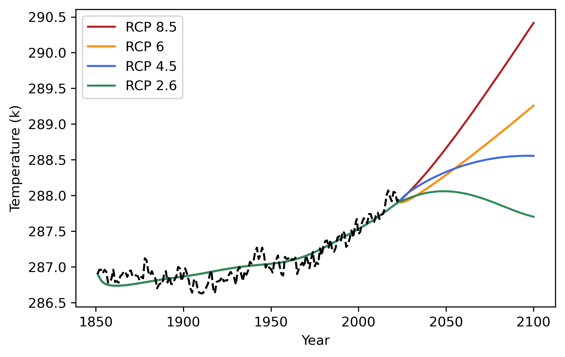
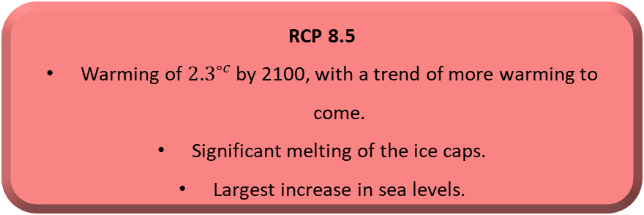
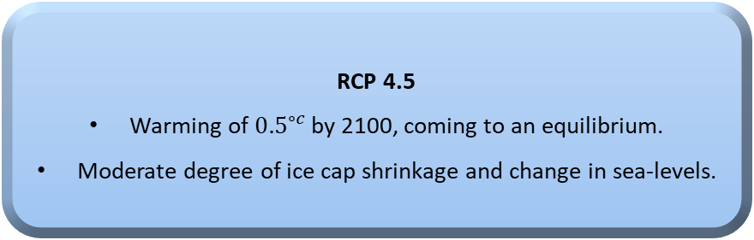
Temperature Forecasts
RCP 8.5
Warming of ${2.3}^{∘c}$ by 2100, with a trend of more warming to come.
Significant melting of the ice caps.
Largest increase in sea levels.
Temperature Forecasts
RCP 4.5
Warming of ${0.5}^{∘c}$ by 2100, coming to an equilibrium.
Moderate degree of ice cap shrinkage and change in sea-levels.
RCP 2.6
Slight decrease in global temperatures
Minimal change in sea-level and ice cap volumes.

Slide 19
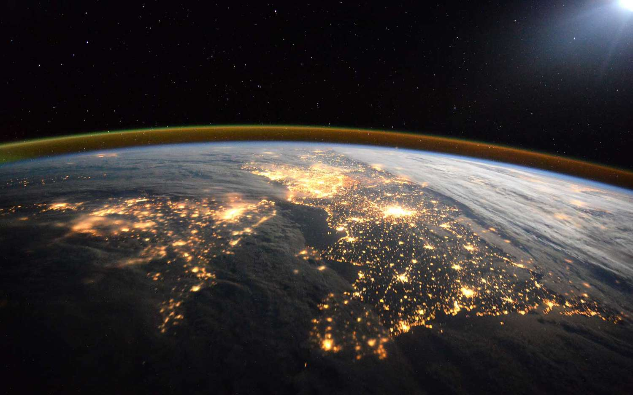
Next Steps
Quantify warming consequences more thoroughly
Model frequency of wildfires & droughts
Q&A
(ESA)

